Slide 1

Week 1 – Video 2 mARKETS
Professor Nico Voigtländer
Management 405: Module 1

Slide 2
outline of module 1
Basic Principles of Economic Thinking
Economic costs include opportunity costs
Ignore sunk costs
Use cost-benefit and marginal analysis
Economics Fundamentals
Markets
Demand and Supply
Equilibrium

Slide 3
Market DEFINITION
A company must understand its market
Customers
Competitors (actual and potential)
Extent of market
Which products belong to a market?
Simple test to identify the range of products in your market: If the price of another product changes, will demand for your product change?
Relevant for antitrust litigation (in mergers & acquisitions)
Geography boundaries
Coffee shop in Venice (CA) v. gasoline retail v. gold

Slide 4

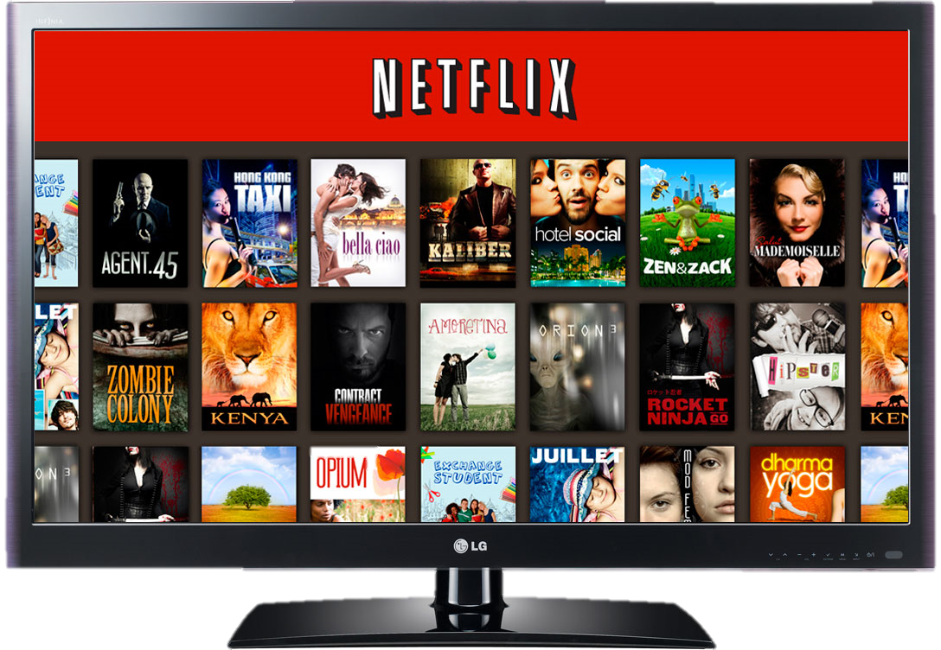
Market DEFINITION: the case of netflix
Define Netflix’s market
Online streaming?
All films?
All entertainment?
Did the market change with Covid-19?
Prepare for class discussion

Slide 5
Actors in the Market
CONSUMERS
Objective: Maximize “utility” from goods and services, given their limited income
WORKERS
Choose a job to earn income
Face trade-offs in their choice of employment
E.g. labor income vs. leisure time / flexibility
FIRMS
Employ workers to produce goods and services for consumers
Objective: Maximize profits (value of the firm)

